Slide 1
Live Streaming Weather and crunching Big Weather numbers
Anantha Shankar Arun Kumar
Siddhartha Singh

Slide 2
Big Numbers
Data generated by “The Weather Company” everyday?
% of world GDP affected by the company “Weather Analytics”?

Slide 3
Weather Company
Generates 4GB of data each second.
Analyzes data from 3 billion weather forecast reference points, over 40 million phones, 50,000 flights per day.
More than ~300 Terabytes
~30-35% of world GDP is affected by the company “Weather Analytics”

Slide 4
What we have done
1. Live streamed weather data in real time in a fast, scalable and fault tolerant environment, stored it in persistence data sources and displayed it in a dashboard.
2. Gathered data exchanged under the World Meteorological Organization(WMO) Weather Watch Program. The data is the Global surface summary of the day(GSOD) produced by the the National Climatic Data Center(NCDC). We collected 27 years of data(1990-2016) and analyzed it.

Slide 5
20 Biggest Cities
London
Paris
Madrid
Karachi
New Delhi
Seoul
Tokyo
Beijing
Cairo
Toronto
Los Angeles
Las Vegas
Boston
New York City
Chicago
Washington DC
Mexico City
Rio De Janerio
Sydney
Manila

Slide 6
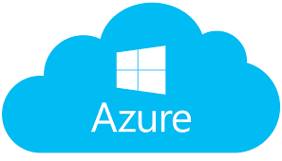








Technologies and frameworks used

Slide 7
Advantages
Increased revenue
Essential for planning
Wider audiences
Cost effective
Convenience

Slide 8


BUT WHY?
Intelligent cars

Slide 9

Intelligent Homes

Slide 10

Planning a vacation

Slide 11
More Advantages
Severe Weather Alerts which will notify you of impending adverse weather such as thunderstorms, hail, hurricanes, flooding, etc.
We can predict when it will rain or snow – down to the minute – at your exact location anywhere we have radar coverage.

Slide 12
The flow
We used Apache Kafka to produce events by calling Forecast.io API, the data is then ingested and processed through Apache Storm and then stored in multiple sources like HBase and Hive. This data is finally produced through Tableau to show different projections and connection between the data.
We ran map reduce on the GSOD data of 27 years and then ran linear regression which, predict the forecast for a day in the future.

Slide 13
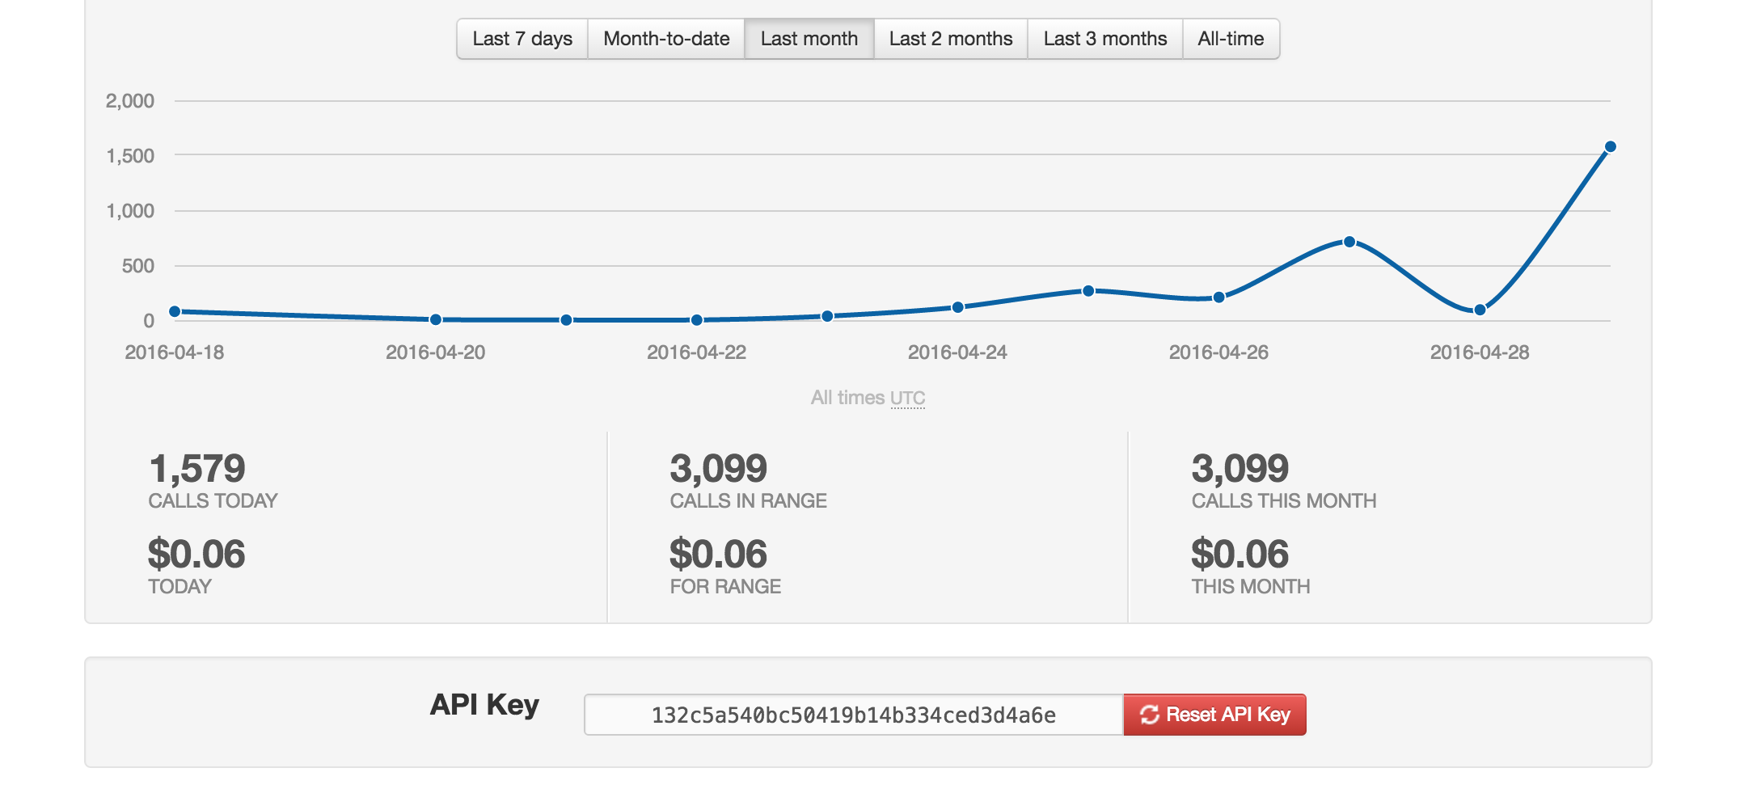
Forecast.IO API

Slide 14

Hortonworks Sandbox
Hortonworks Sandbox is a personal, portable Apache Hadoop environment.
Hortonworks was installed on azure and runs like a virtual machine. It comes installed with Apache Ambari which makes it easier to manage Hadoop clusters.

Slide 15

Apache Storm

Slide 16
What is Storm?
Apache Storm is a free and open source distributed real-time computation system.
Storm makes it easy to reliably process unbounded streams of data.
Storm can be used with any programming language.

Slide 17
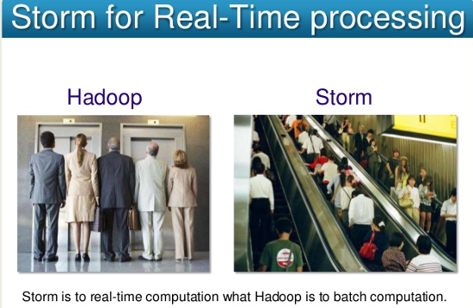

Slide 18
Storm | Hadoop
Real-time stream processing Stateless Master-slave architechture with Zookeeper based coordination. Master node is nimbus and slave node is supervisors. Storm topology runs until shutdown by the user or an unexpected unrecoverable failure | Batch processing Stateful Master-slave architechture with/without Zookeeper based coordination. Master node is job tracker and slave node is task tracker. Mapreduce jobs are executed in a sequential order and completed eventually.

Slide 19
Benefits of storm
Allows real time processing
Storm is unbelievably fast because it has enormous power of processing the data.
Storm performs data refresh and end to end delivery in seconds . It has very low latency.
Storm provides guaranteed data processing even if any of the connected nodes in the cluster die or messages are lost.

Slide 20
Tuple - Main data structure in Storm. It is a list of ordered elements.
Stream - Stream is an unordered sequence of tuples.
Spouts - Source of stream. Storm accepts input data from data sources like Apache Kafka queue, Twitter Streaming API etc.
Bolts – Bolts are logical processing units. Spouts pass data to bolts and bolts process and produce a new output stream.

Slide 21
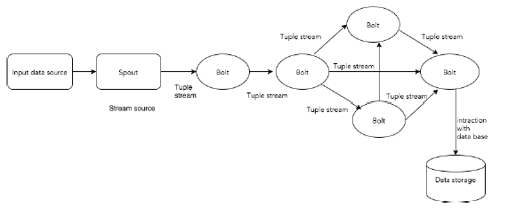
Core Concept

Slide 22
Storm Topology
Spouts and bolts are connected together and they form a topology.
Real-time application logic is specified inside Storm topology.
In simple words, a topology is a directed graph where vertices are computation and edges are stream of data.

Slide 23
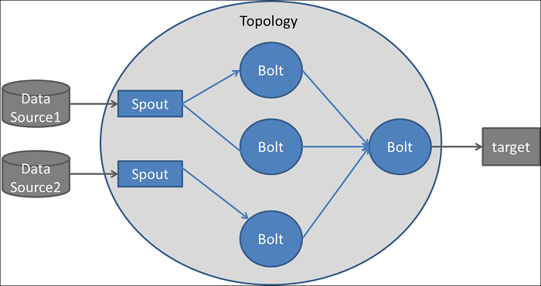

Slide 24
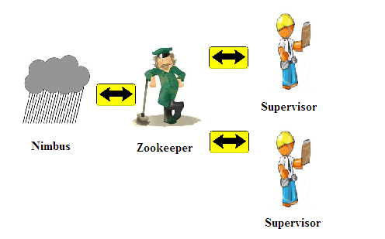
Storm is not entirely stateless. It stores its state in Apache Zookeeper, a failed nimbus can be restarted and made to work from where it left.

Slide 25
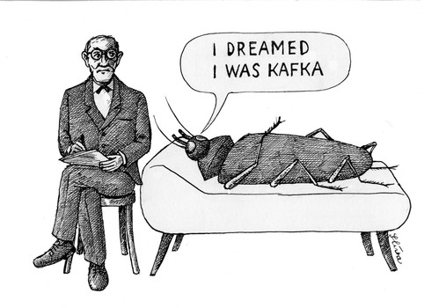
Apache Kafka

Slide 26
Distributed Messaging System
Is based on the concept of reliable message queuing.
Messages are queued asynchronously between client applications and messaging systems.
Most of the messaging patterns follow the publish-subscribe model where senders of the messages are called publishers and those who want to receive the messages are called subscribers.

Slide 27
Apache Kafka
Kafka is a distributed, partitioned, replicated commit log service.
Kafka maintains feeds of messages in categories called topics.
Producers - Processes that publish messages to a Kafka topic.
Consumers – Processes that subscribe to topic and process the feed of published messages.
Broker – Kafka is run as a cluster comprised of one or more servers, each of which is called a broker.

Slide 28
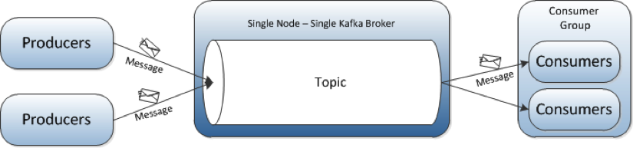
Kafka Layout

Slide 29
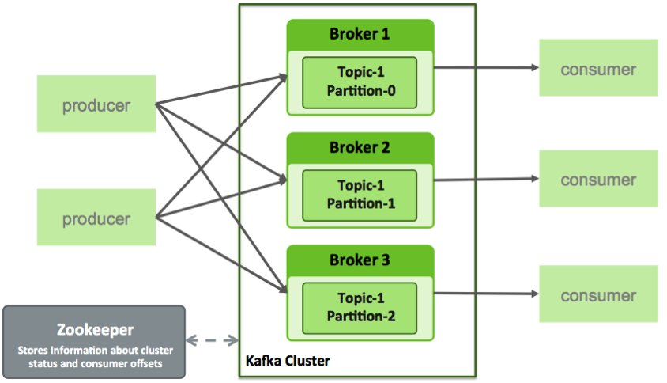

Slide 30
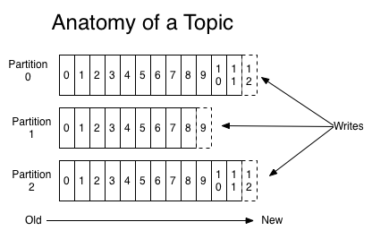
Topic – is a category or feed name to which messages are published.
Kafka retains all published messages- whether or not they have been consumed- for a configurable period of time.

Slide 31
Apache Zookeeper
Zookeeper is a centralized service for maintaining configuration, naming, providing distributed synchronization etc.
It helps in fixing the bugs while implementing distributed application (like race conditions etc)
In our project, zookeeper helps in coordinating storm cluster.
Storm is stateless so zookeeper helps in restarting nimbus node and maintains the state.

Slide 32
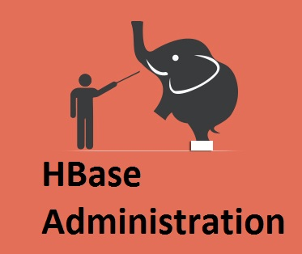
HBase
Provides real-time, random read and write access to tables storing billions of rows and millions of columns.
In this case, once we store this rapidly and continuously growing dataset, we will be able to perform a swift lookup for analytics regardless of the data size.

Slide 33

Apache Hive
Facilitates querying and managing large datasets residing in distributed storage.
Hive provides mechanism to project structure onto this data and query the data using a SQL-like language called HiveQL.

Slide 34
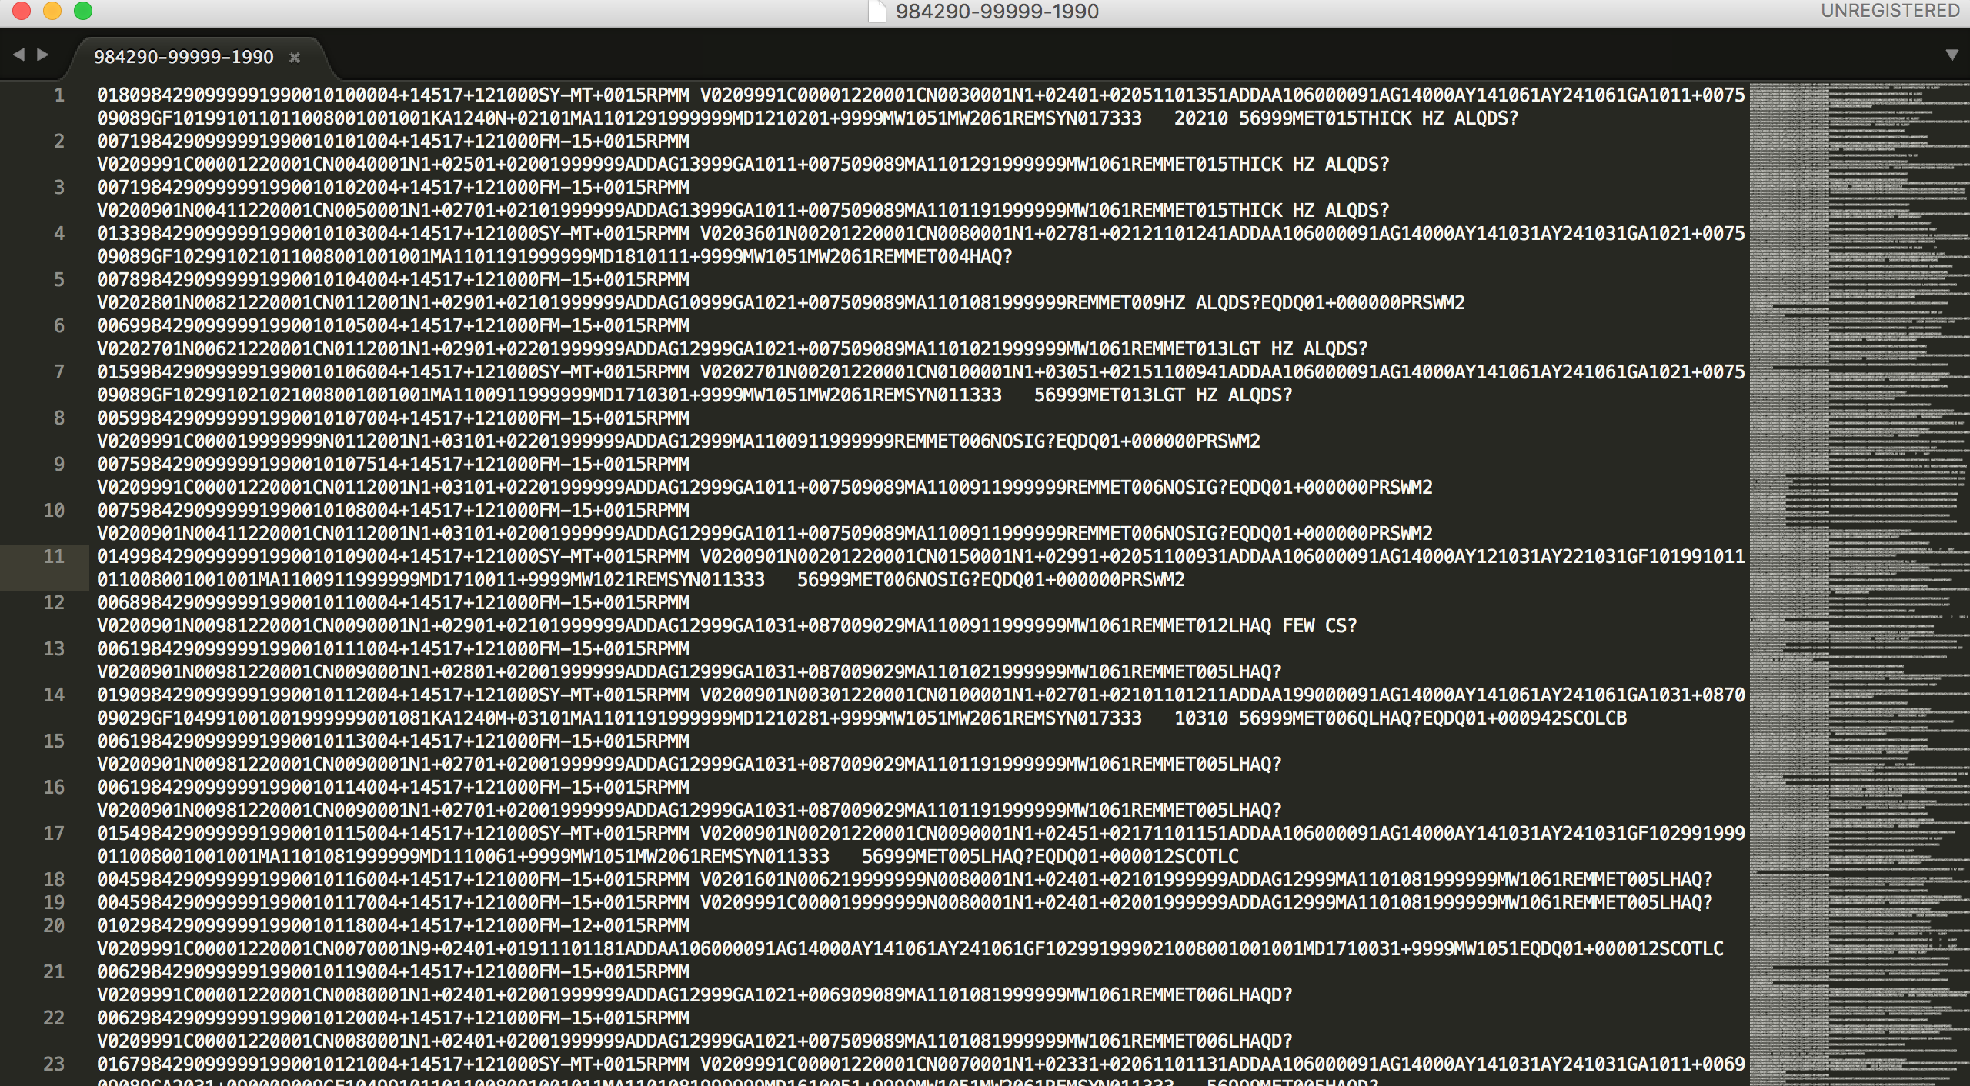
GSOD Data

Slide 35
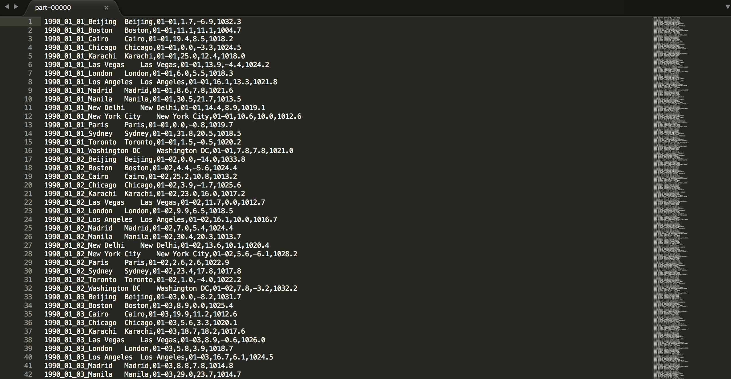
After 1st MR

Slide 36
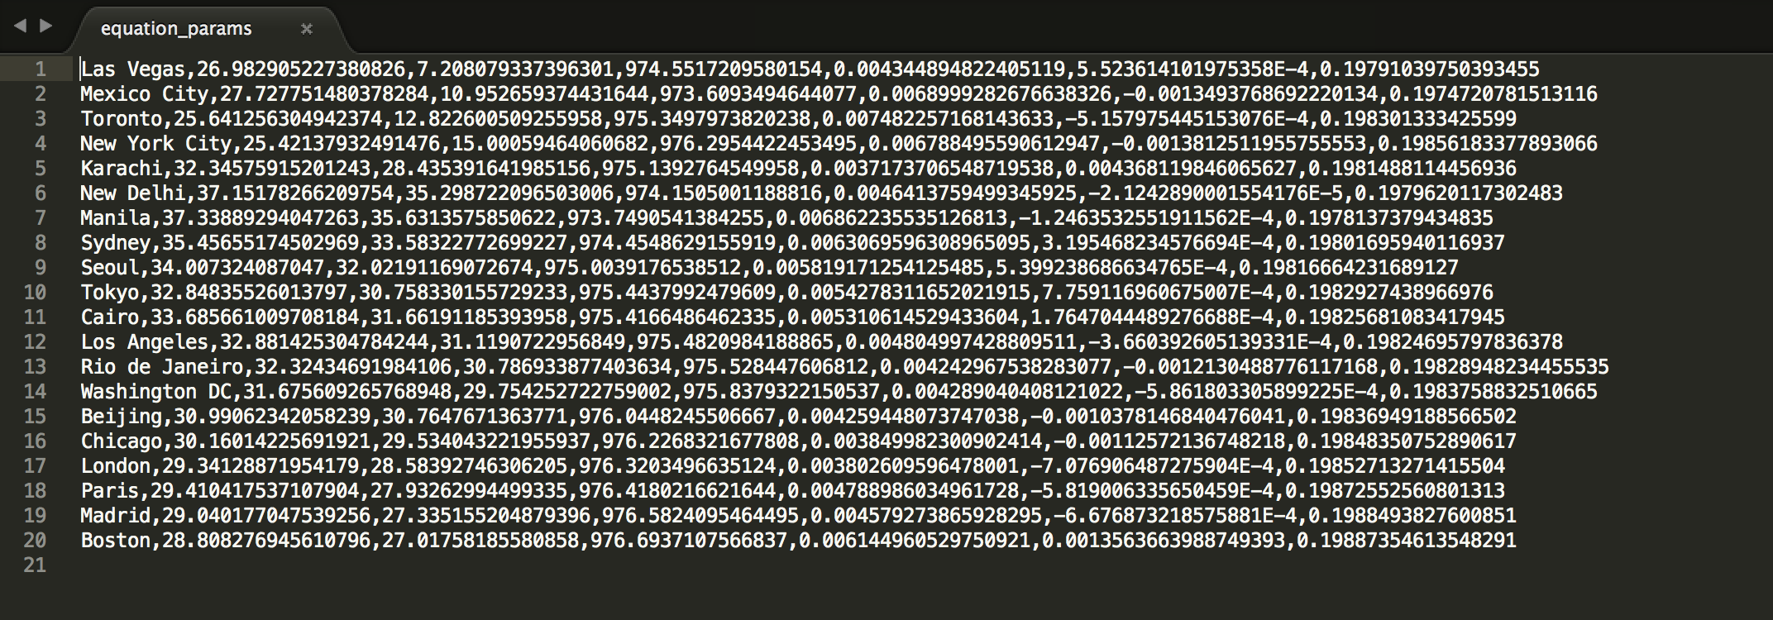
After Linear Regression

Slide 37
Conclusion
You have seen how to store streaming data into multiple sources for persistence and showcased it using a business intelligence tools.
We compared the forecast value we are getting from the API with the value we are getting by linear regression of historical data.

